Slide 1
World Urban Campaign New Vision, Governance and Road Map Summary

Slide 3
1. New WUC Vision

Slide 4
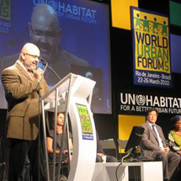
World Urban Campaign: the beginnings
Building on the legacy of the Habitat II Conference (1996)
REVITALIZATION
CHS 17 Res 17/7
GA Res 54/209
GC 20
MTSIP
2008-13
GC 21
partners
consultations
WUC
Steering Committee 1, 2
WUC
SC 3
Rio de Janeiro
1996
1999
2000
2007
2009
2010
Recognition of the two campaigns
WUC
Principles
for Sustainable Urbanization
Campaigns to support the strategic plan
MERGE
into one single campaign to support the strategic plan
LAUNCH
Global Campaigns
Secure Tenure
Urban Governance
LAUNCH OF THE WORLD URBAN CAMPAIGN
Global Campaign on Sustainable Urbanization

Slide 5
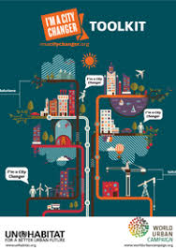
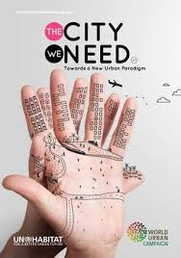
Towards Habitat III
Mission: Promote sustainable urbanization. Unite, connect, enable, measure. Craft a new vision towards Habitat III.
PrepCom2
PrepCom3
WUC
SC 4
Alicante
WUC
SC 5
Shanghai
WUC
SC 6
Amsterdam
WUC
SC 7
Marseille
WUC
SC 8
WUC
SC 9
Nantes
WUC
SC 10
WUC
SC 11
Caserta
WUC
SC 12
Nairobi
WUC
SC 13
New York
WUC
SC 14
Prague
WUC
SC 15
Surabaya
WUC
SC 16
WUC
SC 17
2010
2011
2012
2013
2014
2015
2016
100 Cities Initiative
Tools and methods
Business Award
Good policies and enabling legislations
Manifesto for Cities towards Habitat III
Lobbying for and urban SDG
Recognition of the WUC
Para 128
Better City, Better Life
I’m a City Changer
The City We Need
A manifesto around 10 principles and 10 drivers of change
172 urban solutions
2015-16: 26 UTCs
2017: 59 UTCs for implementing the NUA
2018-19
LEGEND:
SC: WUC Steering Committee

Slide 6
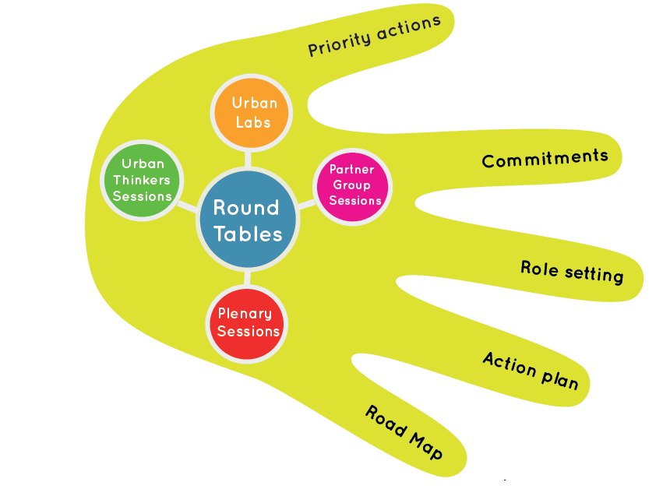
Post Habitat III
WUC Mission: Unite, connect, enable, measure to implement the New Urban Agenda
WUC
SC 19
WUC
SC 20
Liverpool
WUC
SC 20
Nairobi
WUC
SC 22
2018
2020
2018: 26 UTCs
2019: 38 UTCs
The City We Need

Slide 7
WUC VISION 2030
VISION2030
Our Vision
Our Goal
Our Mission
Our Strategic Actions
Our Coalition
What do we promote?
How do we promote?
Our Actions

Slide 8
WUC VISION 2030
VISION2030
Our Vision
Together shaping the future of cities
leaving no one behind.

Slide 9
WUC VISION 2030
VISION2030
Our Goal
Help achieve the urban dimension of the sustainable development goals (SDGs) by 2030 and implement the New Urban Agenda

Slide 10
WUC VISION 2030
VISION2030
Mission
Our mission is to contribute in developing solutions and take action in cities and communities in implementing the New Urban Agenda to accelerate the achievement of the sustainable development goals (SDGs) by 2030.

Slide 11
WUC VISION 2030
VISION2030
Our strategic actions
Advocate and raise-awareness on the role of cities and communities in achieving the SDGs and delivering positive change.
Identify solutions to catalyze action between stakeholders in cities and communities.
Promote actions that have the best potential to scale-up and accelerate the achievement of the SDGs.
Mobilize partners to implement the NUA and accelerate the achievement of the SDGs through specific alliances and joint actions
Measure the results of joint actions and identify concrete achievements towards the SDGs.

Slide 12
WUC VISION 2030
VISION2030
Our coalition
We represent a variety of stakeholders engaged in cities and communities. We thrive to represent all voices through our constituent groups: local and sub-national authorities; research and academia; civil society organizations; grass roots organizations; women; parliamentarians; children and youth; business and industries; foundations and philanthropies; professionals; trade unions and workers; farmers; indigenous people; media; older persons. This variety enables dialogue and cooperation between the partners in the World Urban Campaign and a comprehensive joint outreach on urban issues.

Slide 13
WUC VISION 2030
VISION2030
What do we promote?
The World Urban Campaign promotes the implementation of the New Urban Agenda to achieve the SDGs. It does so through a set of principles and drivers of change as defined in The City We Need.
The City We Need promotes cities that are socially inclusive and engaging; affordable, accessible and equitable; economically vibrant and inclusive; collectively managed and democratically governed. It advocates for cities that foster cohesive territorial development, is regenerative and resilient, have shared identities and sense of place. It promotes well planned, walkable, and transit-friendly, safe, healthy and it promotes well-being, and cities that learn and innovate.

Slide 14
WUC VISION 2030
VISION2030
How do we promote?
The World Urban Campaign engages a variety of organizations and the general public through action campaigns on key areas to raise awareness on critical issues and promote positive urban changes.
The World Urban Campaign promotes policy dialogues to discusses urban issues, identify solutions and take action through initiatives developed and implemented locally along agreed platforms such as the Urban Thinkers Campus.
Solutions and actions are documented and lessons learned shared broadly for improving future actions.

Slide 15
WUC VISION 2030
VISION2030
Our actions are driven by the following principles:
Ambition: With just 10 years to go to meet the targets of the SDGs, we need to have ambitious goals commensurate with the global effort needed to deliver the 2030 promise under the Decade of Action.
Collaboration: we conceive and deliver action in a spirit of collaboration and mutual support among the diverse community of partners, complementing each other rather than competing. We thrive to build synergies in order to catalyse action as needed in implementing the NUA to accelerate the achievement of the SDGs. Urban Thinkers Campuses are the key platforms to do so.
Result-driven: Our actions are driven by results that are measurable. We are accountable, transparent and we monitor our actions on the ground and demonstrate impacts of solutions in cities and communities. Our contributions to the SDGs are tangible.
Partnership: We thrive to deliver in partnership with UN-Habitat.

Slide 16
Transformative action
GLOBAL
LOCAL
Ten years to deliver change from global to local in cities and communities together.
A Global Catalyst
for Urban Change
WUC Platform: an interface with UN-Habitat to catalyze action.

Slide 17
2. WUC Governance

Slide 18
Current WUC membership types
individuals cannot be members
Lead Partners (33)
Have an MoU with UN-Habitat
Sponsors (2)
Have an MoU with UN-Habitat
Associate Partners (140)
Are part of the Steering Committee (can vote)
Promote WUC activities and communication
Provide in-kind contribution to WUC core activities
Are part of the Steering Committee (can vote)
Promote WUC activities and communication
Provide in-kind and cash contribution to WUC core activities
Sign Statement of Commitments
Are observers in the Steering Committee
Promote WUC activities and communication
Provide in-kind contribution to WUC core activities
Members (20)
Media Partners (7)
Sign Statement of Commitments
Are observers in the Steering Committee
Promote WUC activities and communication
Sign Statement of Commitments
Are observers in the Steering Committee
Promote WUC communication

Slide 19
WUC current Governance
Executive Director
WUC Steering Committee
The WUC governing body:
- Advisory body to the Executive Director
Catalizing, action-planning and monitoring organ
Composed of LEAD Partners and Sponsors only
Roles:
Establishing goals, objectives, mission statement
Defining activities, strategies, annual workplan
Setting procedures governing the WUC
WUC Secretariat
Secretariat of the World Urban Campaign, coordinating the Steering Committee
Roles:
Guidance and liaison with partners to carry out agreed activities
Development of processes and protocols to match campaign goals and strategies with partners’ interests
Interface with UN-HABITAT divisions and programmes
Mainstreaming of the Campaign throughout the organization
Coordination among partners, among committees and between committees
Coordinating workplan and events
Organizing external flow of information
Monitoring partners activities
WORLD URBAN CAMPAIGN – WUC Steering Committee ToRs
WUC Standing Committee
Executive organ of the Steering Committee
Roles:
Setting and approving agendas
Reviewing progress report
Approving expenditures
Reviewing new member applications
Monitoring the composition of Steering Committee (STC)
Working groups or Sub-Committee
Tools and Methods
Good policies and enabling legislations
100 Cities Initiative
Communication
Resource mobilization
Monitoring and reporting

Slide 20
Currently Partners Constituencies Groups (PCGs) form
the STANDING committee
WUC Standing Committee
Local and Subnational Authorities
Research and Academia
Civil Society Organizations
Grassroots Organizations
Women
Parliamenta-rians
Children and Youth
Business and Industries
Foundations and Philanthropies
Professionals
Trade Unions and Workers
Farmers
Indigenous people
Older Persons
Persons with Disabilities (*)
Medias
WORLD URBAN CAMPAIGN – WUC Steering Committee ToRs
Notes:
You are part of the 16 partner groups of the WUC.
Your contributions are all equally important.
Thank you for your mobilization and in advance for your participation in this campus.
At UN-Habitat, we value your engagement, your ideas and commitment to the New Urban Agenda.

Slide 21
NEW simplified governance
Executive Director
ERSKI Director
WUC Steering Committee
Comprised of (maximum) 16 elected representatives of the various constituencies
Chaired by (2-3) elected representatives for a two-year mandate between two World Urban Forums
WUC Governing body
Advisory to the Executive Director
Quarterly meeting
Roles:
Establishing goals, objectives, mission statement
Defining activities, strategies, annual workplan
Setting procedures governing the WUC
Composed of PCG Chairs
WUC Secretariat
Guidance and liaison with partners to carry out agreed activities
Interface with UN-Habitat programmes, mainstreaming of WUC throughout the organization
Coordination of Steering Committee and working groups, workplan and events
Organizing external flow of information
Monitoring and reporting partners activities
Meets quarterly online
No Standing Committee
Working group 1:
role defined as required
participation of all partners
Working group 2:
role defined as required
participation of all partners
Working group 3:
role defined as required
participation of all partners
WUC Assembly
Share and exchange on results of activities
Meet at least once a year (all members)
Allows the participation of everyone

Slide 22
NEW WUC membership types
Partners
Sign Statement of Commitments (including sign up The City We Need)
Sponsors
Have a financial contribution agreement with UN-Habitat on the World Urban Campaign
City Changers
All participants in UTCs may become ‘City Changers’
Sign up to The City We Need
Eligible to take part in thematic webinars, meetings
Receive regular information on WUC activities
Eligible to take part in the Steering Committee
Promote WUC activities and communication
Commit to key areas of change to be shared and monitored
Eligible to take part in the Steering Committee
Promote WUC activities and communication
Receive special visibility as sponsor
Demonstrate a contribution to the WUC
Combines Lead and Associate Partners – No MoU needed
Allows individuals to take part in the campaign

Slide 23
NEW: Constituencies Partners Groups form
the STEERING committee
BEFORE they were forming the STANDING Committee
WUC Steering Committee
Local and Subnational Authorities
Research and Academia
Civil Society Organizations
Grassroots Organizations
Women
Parliamenta-rians
Children and Youth
Business and Industries
Foundations and Philanthropies
Professionals
Trade Unions and Workers
Farmers
Indigenous people
Older Persons
Persons with Disabilities (*)
Medias
WORLD URBAN CAMPAIGN – WUC Steering Committee ToRs
Notes:
You are part of the 16 partner groups of the WUC.
Your contributions are all equally important.
Thank you for your mobilization and in advance for your participation in this campus.
At UN-Habitat, we value your engagement, your ideas and commitment to the New Urban Agenda.

