Slide 1
World Urban Campaign Assembly 1 18 June 2020 - 2:00-3:30 PM (CET)

Slide 2
WELCOME by Christine Knudsen Director of External Relations, Strategy, Knowledge and Innovation UN-Habitat
ASSEMBLY#1

Slide 3
Draft Agenda
(2:00-2:05) Welcome by Christine Knudsen, Director of External Relations, Strategy, Knowledge and Innovation, UN-Habitat
(2:05-2:15) Introduction by WUC Chairs Bert Smolders, Sri Sofjan, Sandeep Chachra: the future of the WUC in the context of the COVID-19 crisis
WUC Vision 2030 (WG#1)
(2:15-2:20) Presentation by Bert Smolders
(2:20-2:30) Open discussion
Key elements for a new WUC governance
(2:30-2:35) Presentation by Sri Sofjan
(2:35-2:50) Open discussion
Key directions for future UTCs
(2:50-2:55) Presentation by Sandeep Chachra
(2:55-3:10) Open discussion
(3:10-3:20) Preparation of next elections for PCG Chairs and upcoming events
(3:20-3:25) Any other business
(3:25-3:30) Conclusion by Sri Sofjan
ASSEMBLY#1

Slide 4
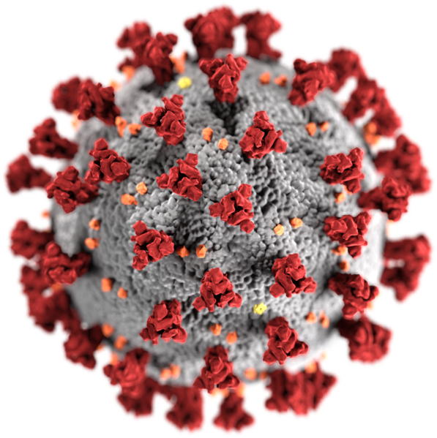
Introduction: The future of the WUC in the context of the COVID-19 crisis

Slide 5
#TakeAction4Cities

Slide 6
1. WUC VISION

Slide 7
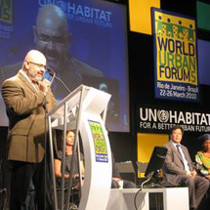
BACKGROUND – 1: the start of the WUC
Building on the legacy of Habitat II
REVITALIZATION
CHS 17 Res 17/7
GA Res 54/209
GC 20
MTSIP
2008-13
GC 21
partners
consultations
WUC
Steering Committee 1, 2
WUC
SC 3
Rio de Janeiro
1996
1999
2000
2007
2009
2010
Recognition of the two campaigns
WUC
Principles
for Sustainable Urbanization
Campaigns to support the strategic plan
MERGE
into one single campaign to support the strategic plan
LAUNCH
Global Campaigns
Secure Tenure
Urban Governance
LAUNCH OF THE WORLD URBAN CAMPAIGN
Global Campaign on Sustainable Urbanization

Slide 8
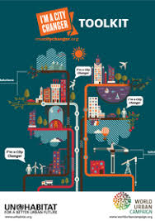
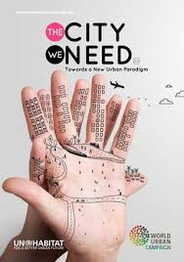
Unite, connect, enable, measure, towards Habitat III
BACKGROUND – 2: Towards Habitat III
PrepCom2
PrepCom3
WUC
SC 4
Alicante
WUC
SC 5
Shanghai
WUC
SC 6
Amsterdam
WUC
SC 7
Marseille
WUC
SC 8
WUC
SC 9
Nantes
WUC
SC 10
WUC
SC 11
Caserta
WUC
SC 12
Nairobi
WUC
SC 13
New York
WUC
SC 14
Prague
WUC
SC 15
Surabaya
WUC
SC 16
WUC
SC 17
2010
2011
2012
2013
2014
2015
2016
100 Cities Initiative
Tools and methods
Business Award
Good policies and enabling legislations
Manifesto for Cities towards Habitat III
Lobbying for and urban SDG
Recognition of the WUC
Para 128
Better City, Better Life
I’m a City Changer
The City We Need
A manifesto around 10 principles and 10 drivers of change
172 urban solutions
2015-16: 26 UTCs
2017: 59 UTCs for implementing the NUA
2018-19
LEGEND:
SC: WUC Steering Committee

Slide 9
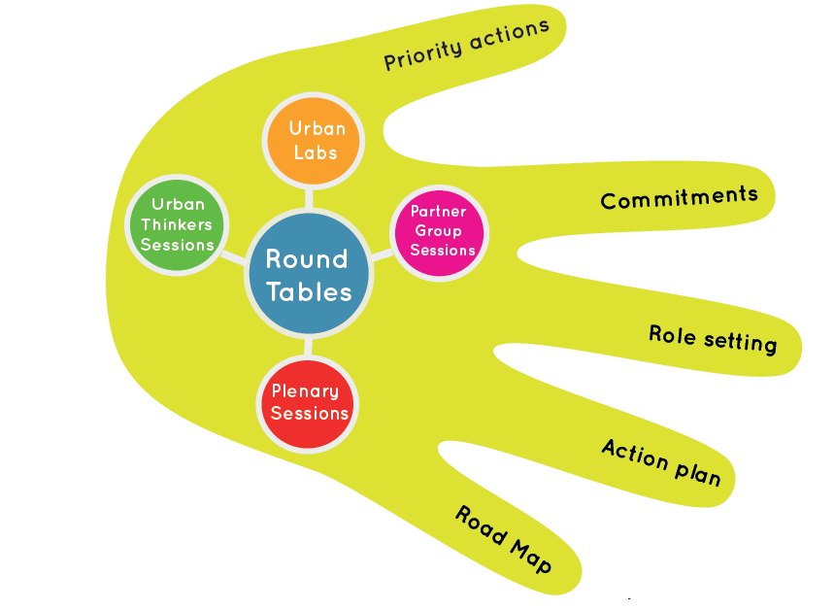
Unite, connect, enable, measure, to implement the New Urban Agenda
BACKGROUND – 3: Post Habitat III
WUC
SC 19
WUC
SC 20
Liverpool
WUC
SC 20
Nairobi
WUC
SC 22
2018
2020
2018: 26 UTCs
2019: 38 UTCs
The City We Need

Slide 10
Ten years to deliver change in cities and communities.
VISION2030
VISION2030
Our Coalition
Our Mission
Our Goals
What do we promote?
How do we promote?
Our Actions

Slide 11
VISION2030
Our coalition
We represent a variety of stakeholders engaged in cities and communities. We thrive to represent all voices through our constituent groups: local and sub-national authorities; research and academia; civil society organizations; grass roots organizations; women; parliamentarians; children and youth; business and industries; foundations and philanthropies; professionals; trade unions and workers; farmers; indigenous people; media; older persons. This variety enables dialogue and cooperation between the partners in the World Urban Campaign and a comprehensive joint outreach on urban issues.

Slide 12
VISION2030
Our mission is to contribute in developing solutions and take action in cities and communities in implementing the New Urban Agenda to accelerate the achievement of the sustainable development goals (SDGs) by 2030.

Slide 13
VISION2030
Our goals
Advocate and raise-awareness on the role of cities and communities in achieving the SDGs and delivering positive change.
Identify solutions to catalyze action between stakeholders in cities and communities.
Promote actions that have the best potential to scale-up and accelerate the achievement of the SDGs.
Mobilize partners to implement the NUA and accelerate the achievement of the SDGs through specific alliances and joint actions
Measure the results of joint actions and identify concrete achievements towards the SDGs.

Slide 14
VISION2030
What do we promote?
The World Urban Campaign promotes the implementation of the New Urban Agenda to achieve the SDGs. It does so through a set of principles and drivers of change as defined in The City We Need.
The City We Need promotes cities that are socially inclusive and engaging; affordable, accessible and equitable; economically vibrant and inclusive; collectively managed and democratically governed. It advocates for cities that foster cohesive territorial development, is regenerative and resilient, have shared identities and sense of place. It promotes well planned, walkable, and transit-friendly, safe, healthy and it promotes well-being, and cities that learn and innovate.

Slide 15
VISION2030
How do we promote?
The World Urban Campaign engages the general public through action campaigns on key areas to raise awareness on critical issues and promote positive urban changes.
The World Urban Campaign promotes policy dialogues to discusses urban issues, identify solutions and take action through initiatives developed and implemented locally along agreed platforms such as the Urban Thinkers Campus.
Solutions and actions are documented and lessons learned shared broadly for improving future actions.

Slide 16
VISION2030
Our actions are driven by the following principles:
Ambition: With just 10 years to go to meet the targets of the SDGs, we need to have ambitious goals commensurate with the global effort needed to deliver the 2030 promise under the Decade of Action.
Collaboration: we conceive and deliver action in a spirit of collaboration and mutual support among the diverse community of partners, complementing each other rather than competing. We thrive to build synergies in order to catalyse action as needed in implementing the NUA to accelerate the achievement of the SDGs. Urban Thinkers Campuses are the key platforms to do so.
Result-driven: Our actions are driven by results that are measurable. We are accountable, transparent and we monitor our actions on the ground and demonstrate impacts of solutions in cities and communities. Our contributions to the SDGs are tangible.
Partnership: We thrive to deliver in partnership with UN-Habitat, in particular around its flagship programmes.

Slide 17
>> Partnership
We thrive to deliver in partnership with UN-Habitat, in particular around its flagship projects:
2030
Leaving no one and no place behind.
2020
2030
SDG Acceleration
SDG Cities Global Initiative
Digital Transformation
People Centered Smart Cities
Inequality
Inclusive Vibrant Neighbourhoods and Communities
Climate Change
Climate Resilience of the Poor
Migration
Inclusive Cites – Enhancing the Positive Impacts of Migration
Five Flagship
Programmes to articulate action campaigns

Slide 18
URBAN
Transformative action
GLOBAL
LOCAL
Ten years to deliver change from global to local in cities and communities together.
A Global Catalyst
for Urban Change
WUC Platform: an interface with UN-Habitat to catalyze action.

Slide 19
2. WUC Governance

Slide 20
WUC current Governance
Executive Director
WUC Steering Committee
The WUC governing body:
- Advisory body to the Executive Director
Catalizing, action-planning and monitoring organ
Composed of LEAD Partners and Sponsors only
Roles:
Establishing goals, objectives, mission statement
Defining activities, strategies, annual workplan
Setting procedures governing the WUC
WUC Secretariat
Secretariat of the World Urban Campaign, coordinating the Steering Committee
Roles:
Guidance and liaison with partners to carry out agreed activities
Development of processes and protocols to match campaign goals and strategies with partners’ interests
Interface with UN-HABITAT divisions and programmes
Mainstreaming of the Campaign throughout the organization
Coordination among partners, among committees and between committees
Coordinating workplan and events
Organizing external flow of information
Monitoring partners activities
WORLD URBAN CAMPAIGN – WUC Steering Committee ToRs
WUC Standing Committee
Executive organ of the Steering Committee
Roles:
Setting and approving agendas
Reviewing progress report
Approving expenditures
Reviewing new member applications
Monitoring the composition of Steering Committee (STC)
Working groups or Sub-Committee
Tools and Methods
Good policies and enabling legislations
100 Cities Initiative
Communication
Resource mobilization
Monitoring and reporting

Slide 21
Current WUC membership types
individuals cannot be members
Lead Partners (33)
Have an MoU with UN-Habitat
Sponsors (2)
Have an MoU with UN-Habitat
Associate Partners (140)
Are part of the Steering Committee (can vote)
Promote WUC activities and communication
Provide in-kind contribution to WUC core activities
Are part of the Steering Committee (can vote)
Promote WUC activities and communication
Provide in-kind and cash contribution to WUC core activities
Sign Statement of Commitments
Are observers in the Steering Committee
Promote WUC activities and communication
Provide in-kind contribution to WUC core activities
Members (20)
Media Partners (7)
Sign Statement of Commitments
Are observers in the Steering Committee
Promote WUC activities and communication
Sign Statement of Commitments
Are observers in the Steering Committee
Promote WUC communication

Slide 22
Currently Constituencies Partners Groups form
the STANDING committee
WUC Standing Committee
Local and Subnational Authorities
Research and Academia
Civil Society Organizations
Grassroots Organizations
Women
Parliamenta-rians
Children and Youth
Business and Industries
Foundations and Philanthropies
Professionals
Trade Unions and Workers
Farmers
Indigenous people
Older Persons
Persons with Disabilities (*)
Medias
WORLD URBAN CAMPAIGN – WUC Steering Committee ToRs
Notes:
You are part of the 16 partner groups of the WUC.
Your contributions are all equally important.
Thank you for your mobilization and in advance for your participation in this campus.
At UN-Habitat, we value your engagement, your ideas and commitment to the New Urban Agenda.

Slide 23
NEW simplified governance
Executive Director
Composed of PCG Chairs
WUC Steering Committee
Comprised of (maximum) 16 elected representatives of the various constituencies
Chaired by (2-3) elected representatives for a two-year mandate between two World Urban Forums
WUC Governing body
Advisory to the Executive Director on advocacy
Quarterly meeting
WUC Secretariat
Guidance and liaison with partners to carry out agreed activities
Interface with UN-Habitat programmes, mainstreaming of WUC throughout the organization
Coordination of Steering Committee and working groups, workplan and events
Organizing external flow of information
Monitoring partners activities
Meets quarterly online
No Standing Committee
Working group 1:
Vision & Workplan & Monitoring
Working group 2:
TBD
Working group 3:
TBD
More working groups as required
WUC Assembly
Share and exchange on results of activities
Meet at least once a year (all members)
Allows the participation of everyone

Slide 24
NEW WUC membership types
Partners
Sign Statement of Commitments (including sign up The City We Need)
Sponsors
Have a contribution agreement with UN-Habitat
City Changers
All participants in UTCs may become ‘City Changers’
Sign up to The City We Need
Eligible to take part in thematic webinars, meetings
Receive regular information on WUC activities
Eligible to take part in the Steering Committee
Promote WUC activities and communication
Commit to key areas of change to be shared and monitored
Eligible to take part in the Steering Committee
Observer in the Steering Committee
Promote WUC activities and communication
Combines Lead and Associate Partners – No MoU needed
Allows individuals to take part in the campaign

Slide 25
NEW: Constituencies Partners Groups form
the STEERING committee
BEFORE they were forming the STANDING Committee
WUC Steering Committee
Local and Subnational Authorities
Research and Academia
Civil Society Organizations
Grassroots Organizations
Women
Parliamenta-rians
Children and Youth
Business and Industries
Foundations and Philanthropies
Professionals
Trade Unions and Workers
Farmers
Indigenous people
Older Persons
Persons with Disabilities (*)
Medias
WORLD URBAN CAMPAIGN – WUC Steering Committee ToRs
Notes:
You are part of the 16 partner groups of the WUC.
Your contributions are all equally important.
Thank you for your mobilization and in advance for your participation in this campus.
At UN-Habitat, we value your engagement, your ideas and commitment to the New Urban Agenda.

Slide 26
3. Urban Thinkers Campus

Slide 27
First generation
Urban Thinkers Campus
First Generation
The City We Need Debate
Urban Thinkers sessions
Constituent Group sessions
Urban Labs
Drafting sessions
Urban Journalism Academy
Digital Media Academy
Urban Cinema

Slide 28
Urban Thinkers Campus
Second Generation
In addition, UTCs deliver:
Action Plans
Commitments
Collective Road Maps

Slide 29
World Urban Campaign
Urban Thinkers Campus - DATAS

Slide 30
Urban Thinkers Campus
New Generation ?
Action oriented UTC
of partners
UTCs deliver:
Action plan
Commitments of partners
Road map
Monitoring impacts
Implementation Task Team
Action Day
and targets
+ Monitoring Impacts
+ Implementation Task Team

Slide 31
COVID-19 UTCs – A new model?

Slide 32
COVID-19 UTC Series 1
UTC#5- Securidad en la Crisis Covid-19
11 May 2020, 11:30 am - 1:00 pm EDT (= 5:30-7:00 pm CET)
Partner organization: Huairou Commission
UTC#6- Community Leaders at the Frontline
14 May 2020, 2.30 - 4:00 pm
Partner organizations: Huairou Commission, WEA
UTC#7- The Wage Gap, Social Security and Small Business during Pandemics
20 May 2020, 2.30 - 4:00 pm
Partner organizations: ActionAid, Smartly
UTC#8- Planning and Design for Pandemic Urban Resilience
27 May 2020, 2.30 - 4:00 pm
Partner organizations: Arcadis, Isocarp, Commonwealth Association of Planners, Paris Region
UTC#9- Reporting during the pandemic
29 May 2020, 11 am - 12:30 EDT (= 5-6:30 pm CET)
Partner organization: Smartly, First Main Films
UTC#1 – Facing Urban Vulnerabilities
4 May 2020, 2.30 - 4:00 pm CET
Partner organization: Practical Action
UTC#2 - The Basic Services Gap
6 May 2020, 2.30 - 4:00 pm CET
Partner organization: Practical Action
UTC#3- The Shelter Gap
7 May 2020, 2.30 - 4:00 pm CET
Partner organizations: Compass Housing, Habitat for Humanity
UTC4#- The Safety Gap
11 May 2020, 2.30 - 4:00 pm CET
Partner organizations: Red Dot Foudation, Polycom, CJUR International

Slide 33
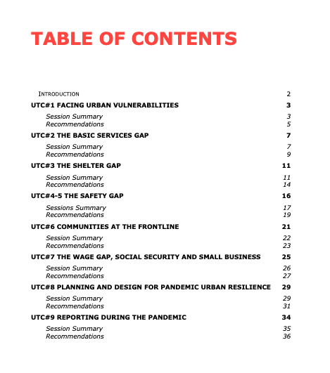

Slide 34
COVID-19 UTC Series 2 (June-July) | DATE | Lead Organization
The New Urban Normal: Urban Sustainability and Resilience post COVID-19 | 17 June 2020 | Delft University of Technology
Cooperative City in Quarantine Finale: Planning the "new" cooperative city or the city after Covid19 or after quarantine | 19 June 2020 | Eutropian
Addressing the expanding demand for Affordable Housing | 22 June 2020 | The International Real Estate Federation (FIABCI)
Urban Research and Education in the Wake of COVID-19: Impacts and Future Prospects | 24 June 2020 | UN-Habitat UNI
Gobernanza multinivel para enfrentar la pandemia y la recuperación (Multi-level governance to face pandemic and recovery) | 24 June 2020 | Smartly
Future of real estate industry post Covid-19, way forward to develop healthy cities | 25 June 2020 | The International Real Estate Federation (FIABCI) Middle East
Mobilizing pro-poor investments for Resilience in the post-COVID economic recovery | 25 June 2020 | UN-Habitat
COVID19 in cities: the role of youth | 25 June 2020 | World Vision International
Mobilizing pro-poor investments for Resilience in the post-COVID economic recovery | 25 June 2020 | UN-Habitat
Public Spaces as Critical Social Infrastructure | 29 June 2020 | Sushant School of Planning and Development, Ansal University
Megacities’ Post-Covid Planning | 3 July 2020 | Metropolitan and Territorial Planning Agencies Global Network
Urban responses to Covid-19 and the localisation of SDG and the New Urban Agenda | 3 July 2020 | Gothenburg Centre for Sustainable Development
Urban Legislation and Climate Change post COVID19 | 3 July 2020 | Colegio de Jurisprudencia Urbanística CJUR Internacional
Financing Recovery for Resilient and Sustainable Cities | 6 July 2020 | Bombay Chamber of Com. & Ind.

Slide 35
COVID-19 UTC Series 2 (June-July) | DATE | Lead Organization
Rethinking Public Spaces | 9 July 2020 | Red Dot Foundation
Architects' response to reshaping our cities that are resilient to pandemic situations. | 11 July 2020 | International Union of Architects
Housing for All to Create Sustainable and Inclusive Cities | 13 July 2020 | Madras Chamber of Com. & Ind.
COVID-19, Cities & Urban Informal Workers: Vision & Agenda For The Future | 14 July 2020 | WIEGO
CITIES IN THE AGE OF COVID 19: LESSONS FOR REPLICATION | 15 July 2020 | Technical University Berlin
Global homelessness response to the Covid19 pandemic | 15 July 2020 | World Habitat
Public Space & Public Life during Covid 19 - Lessons Learned | 15 July 2020 | City of Mannheim/STIRN
Green public spaces for urban resilience building – Approaches, best practices, and uptake | 15 July 2020 | ISOCARP Institute
Grassroots Women Lead in Ensuring City We Need in Inclusive Post Covid-19 through the Community Reilience Fund | 16 July 2020 | HUAIROU Commission
COVID-19: A Catalyst For Sustainable Mobility? | 21 July 2020 | European Urban Knowledge Network (EUKN) EGTC
Climate Action and Energy Policy in the Post Pandemic World | 21 July 2020 | US Green Building Council
Binational Urban Thinkers Campus Mexico - Peru | 23 July 2020 | Bufete de Estudios Interdisciplinarios
Accelerating Affordable and Sustainable Housing | 28 July 2020 | Technical University of Munich
Sustainable Innovation Communities and Post-Coronavirus Resilient Recovery Strategies | 28 July 2020 | Global Urban Development
Urban Thinkers Campus – Facilitating Local Response in Times of Crisis | 29 July 2020 | Urban Inc/ Odaia Creativa Assoc.
Role of multi-level governance for managing pandemics and building resilience of Indian cities | 30 July 2020 | National Institute of Urban Affairs, India
total: 30 UTCs

Slide 36
#TakeAction4Cities
15 April 2020
COVID-19 Campaign launch
20 April 2020
WUC COVID-19 Communiqué
Together facing the COVID-19 crisis and building urban resilience towards The City We Need
Joining partners: 77
Joining individuals: 1,520
UTC Participants: 1,150
JOIN!
https://unhabitat.org/covid-19

Slide 37
Next Steps
PCG Elections
Approval of Vision, ToRs (Governance)
Upcoming events
Next WUC Assembly
AOB

Slide 38
ROAD MAP tentative
Approval of WUC ToRs
Call for PCG elections
ASSEMBLY#1
ASSEMBLY#2
PCG elections
20 July
24 Aug
1 Oct
2 Oct
JUNE
JULY
AUGUST
SEPTEMBER
OCTOBER
NOVEMBER
DECEMBER
COVID-19 UTCs
UTCs Phase 4
30 June
3 August
Urban October
Approval WUC Vision
Call for Proposals UTC Phase 4
4 Oct
31 Oct
World
Habitat
Day
World
Cities
Day

